Slide 1
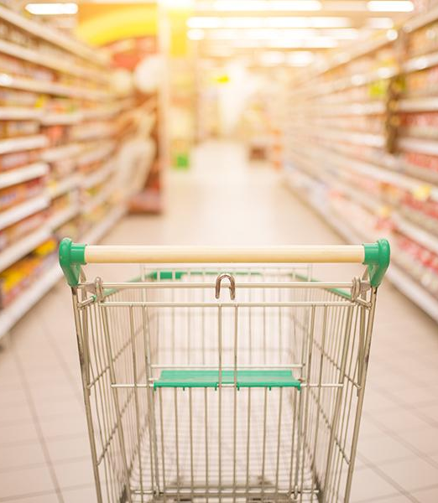


Analyse Promotions and Provide Tangible Insights for Atlique Mart
Vivek
Chouhan

Slide 2


Agenda
Introduction and About the data
Product Analysis
Store Analysis
Promotional analysis
Ad Hoc requests

Slide 3
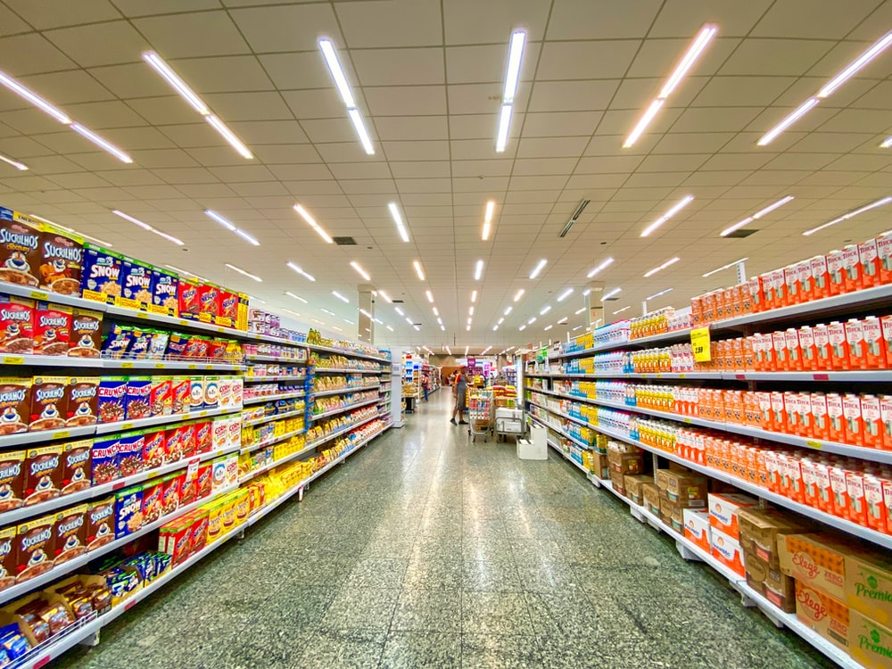
Introduction
Problemstatement: AtliQ Mart, a major retail chain with 50 supermarkets in southern India, conducted large-scale promotions during Diwali 2023 and Sankranti 2024 on their branded products. The sales director seeks to evaluate the effectiveness of these promotions to guide future decisions.
Tech Stack used
MySql
Excel
Python
3

Slide 4


AtliQ Mart conducted promotional campaigns during Diwali and Sankranti in southern India, offering products in categories like Grocery, Home Care, Personal Care, and Home Appliances, along with combo deals. The dataset contains 1500 records detailing various promotional offers such as cashbacks and discounts.
About the data

Slide 5
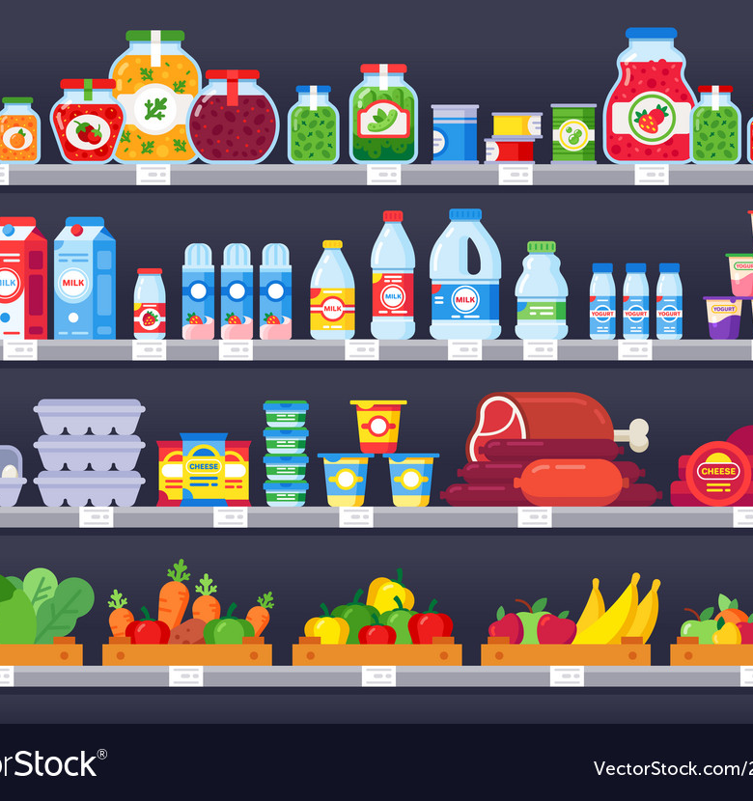
Product Performance

Slide 6
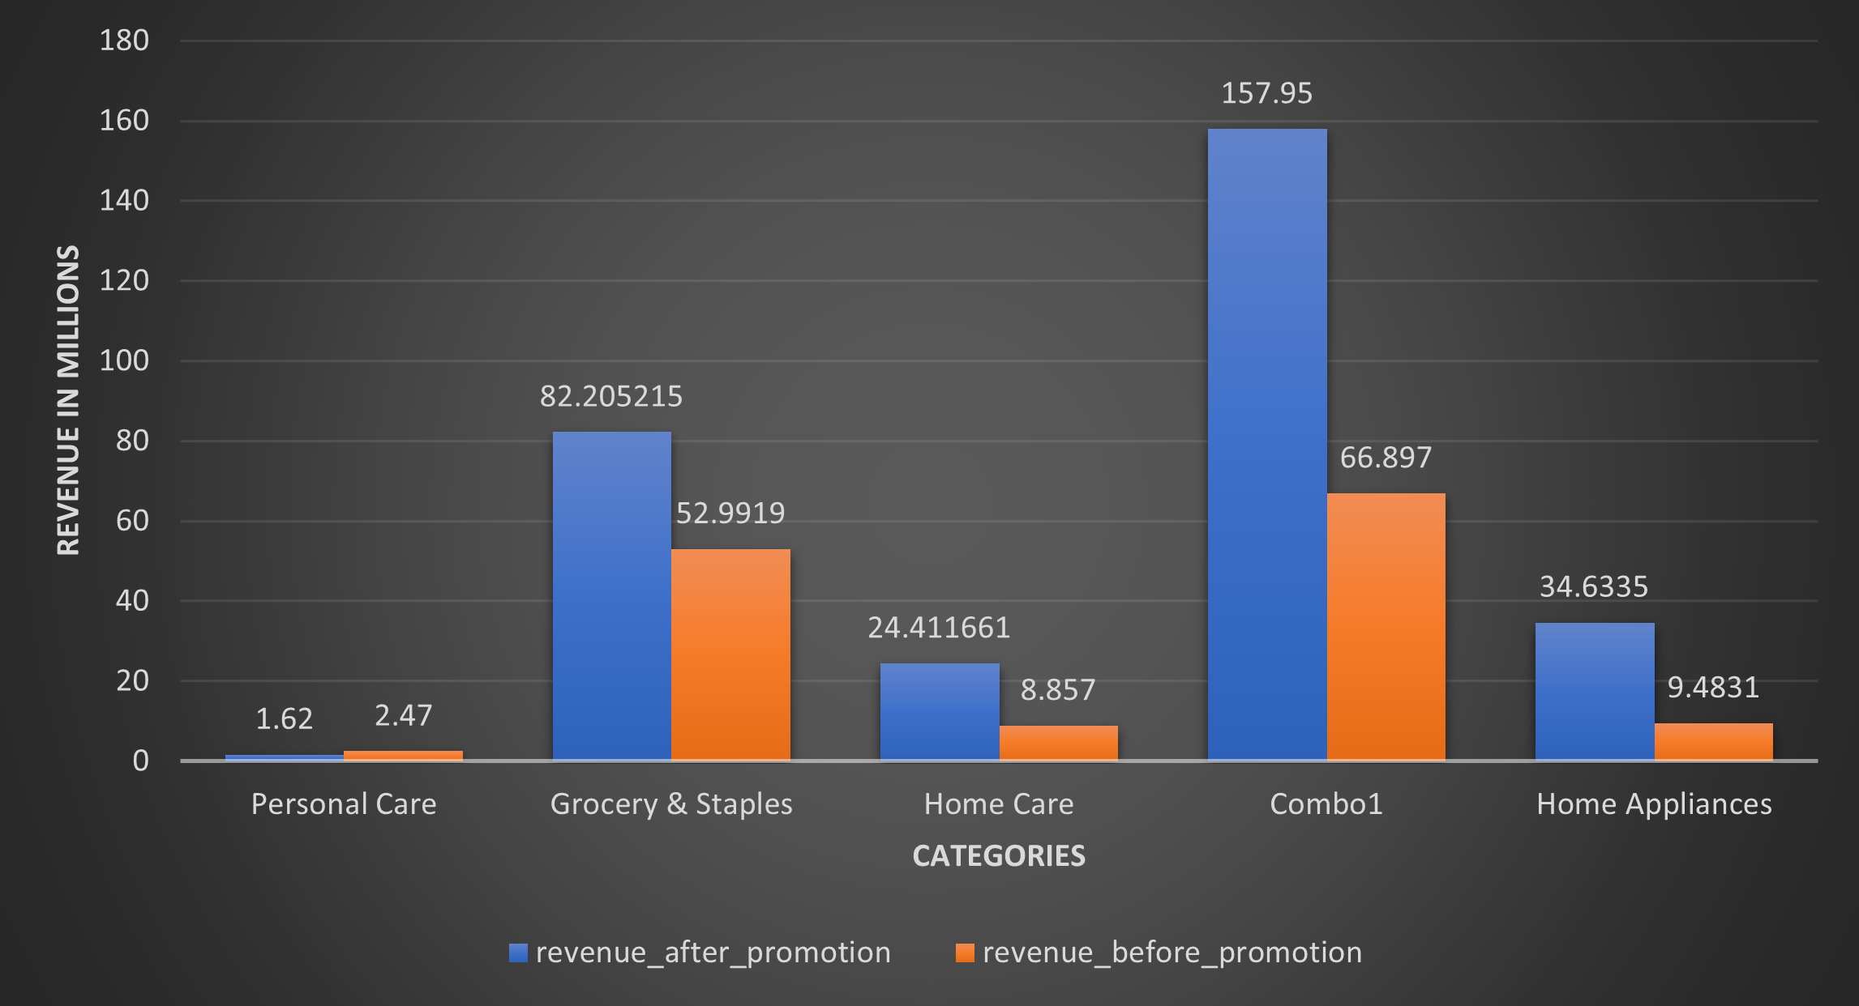
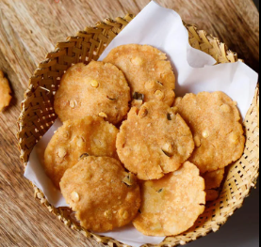
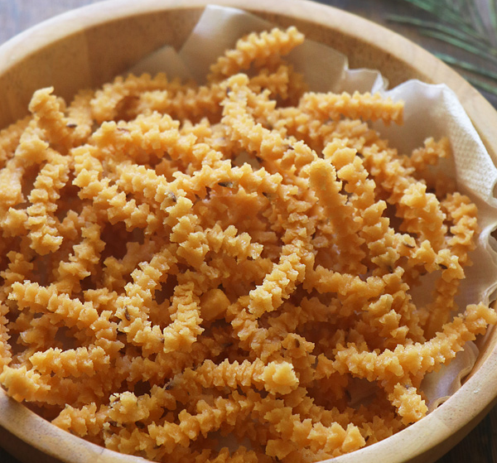
Top product categories with most significant sales during promotional time
Combo1 and Grocery & Staples categories saw strong sales growth, with Combo1 showing a 40% increase during promotions.
Festive cooking traditions drove higher sales in these categories.
Personal Care category experienced lower sales during promotions

Slide 7
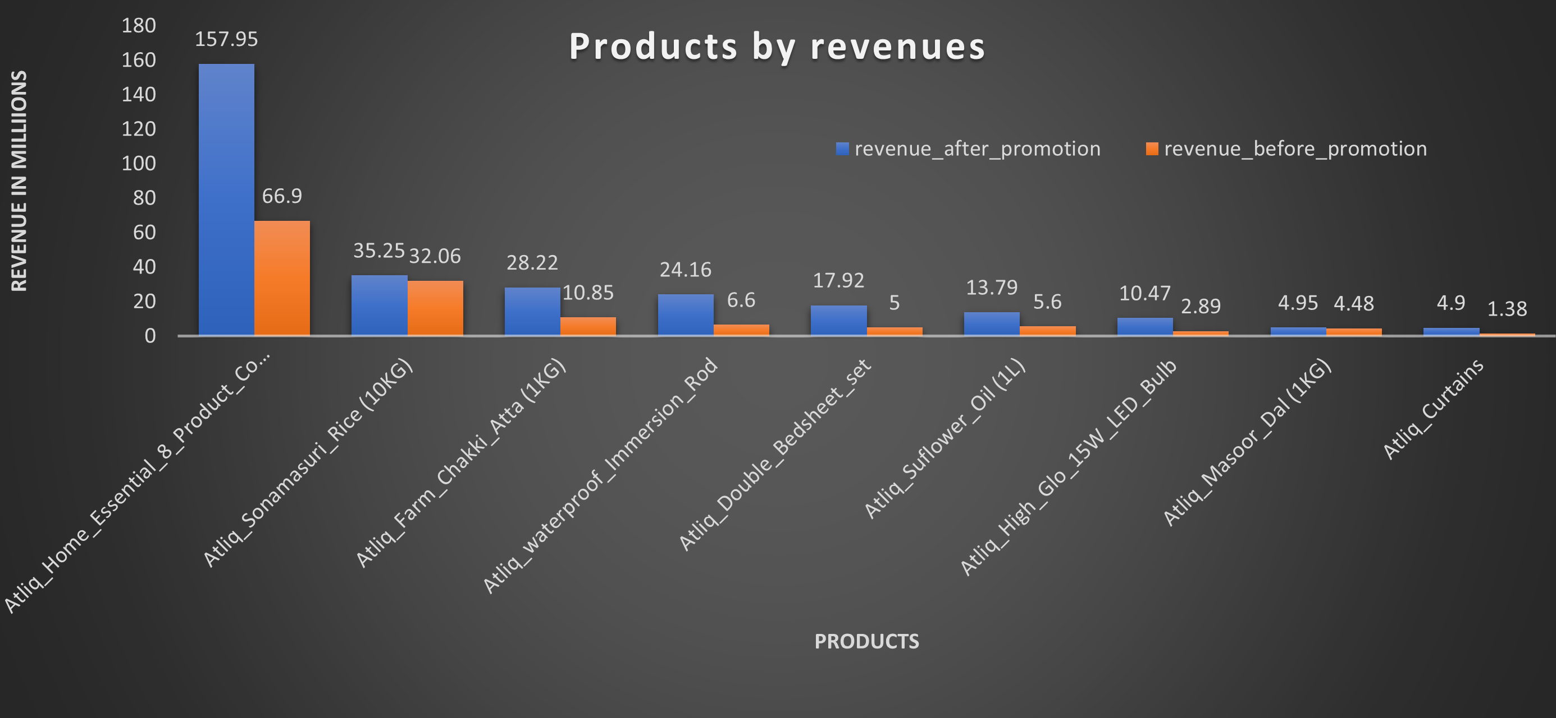
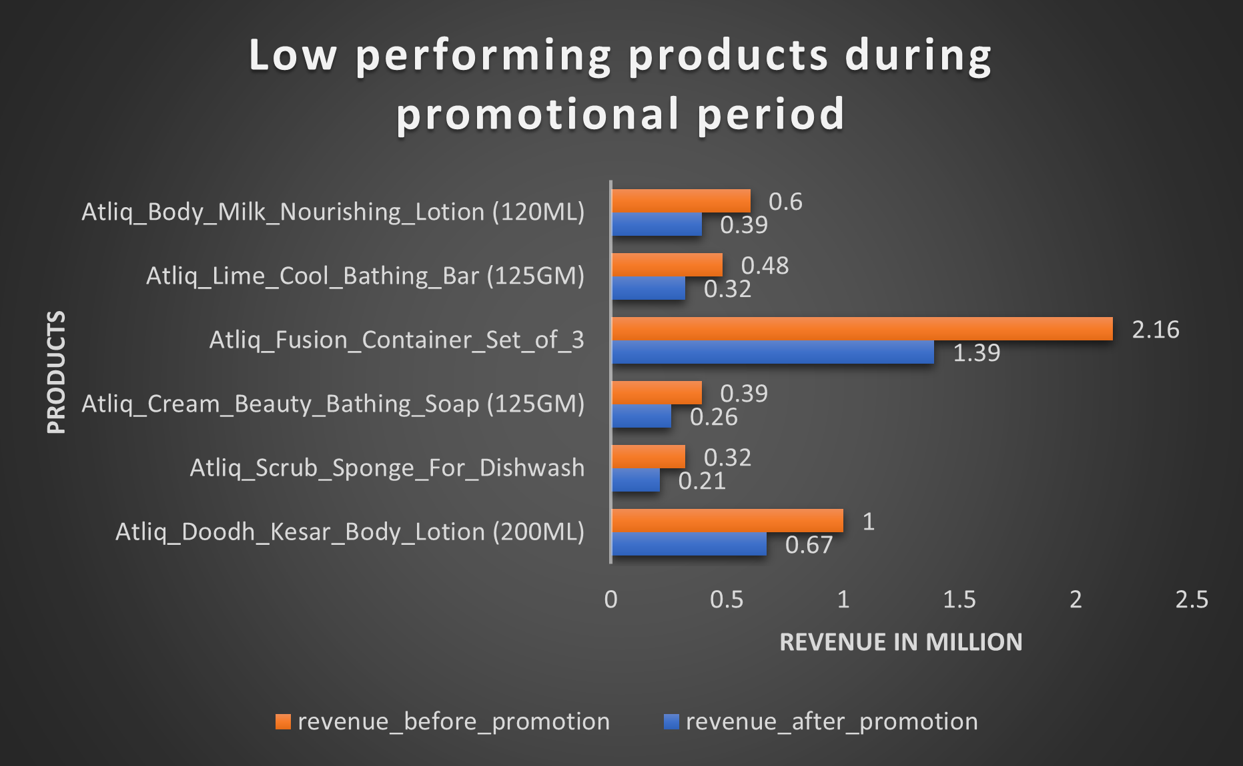
Top product categories with most significant sales during promotional time
Home essential combos, Sonammasuri rice, and atta, along with double bedsheets, saw increased sales during promotions, driven by the need for festive preparations and home decorations.
Personal care product sales peak before promotions, suggesting consumers stock up in anticipation, indicating a consumer behavior trend.

Slide 8
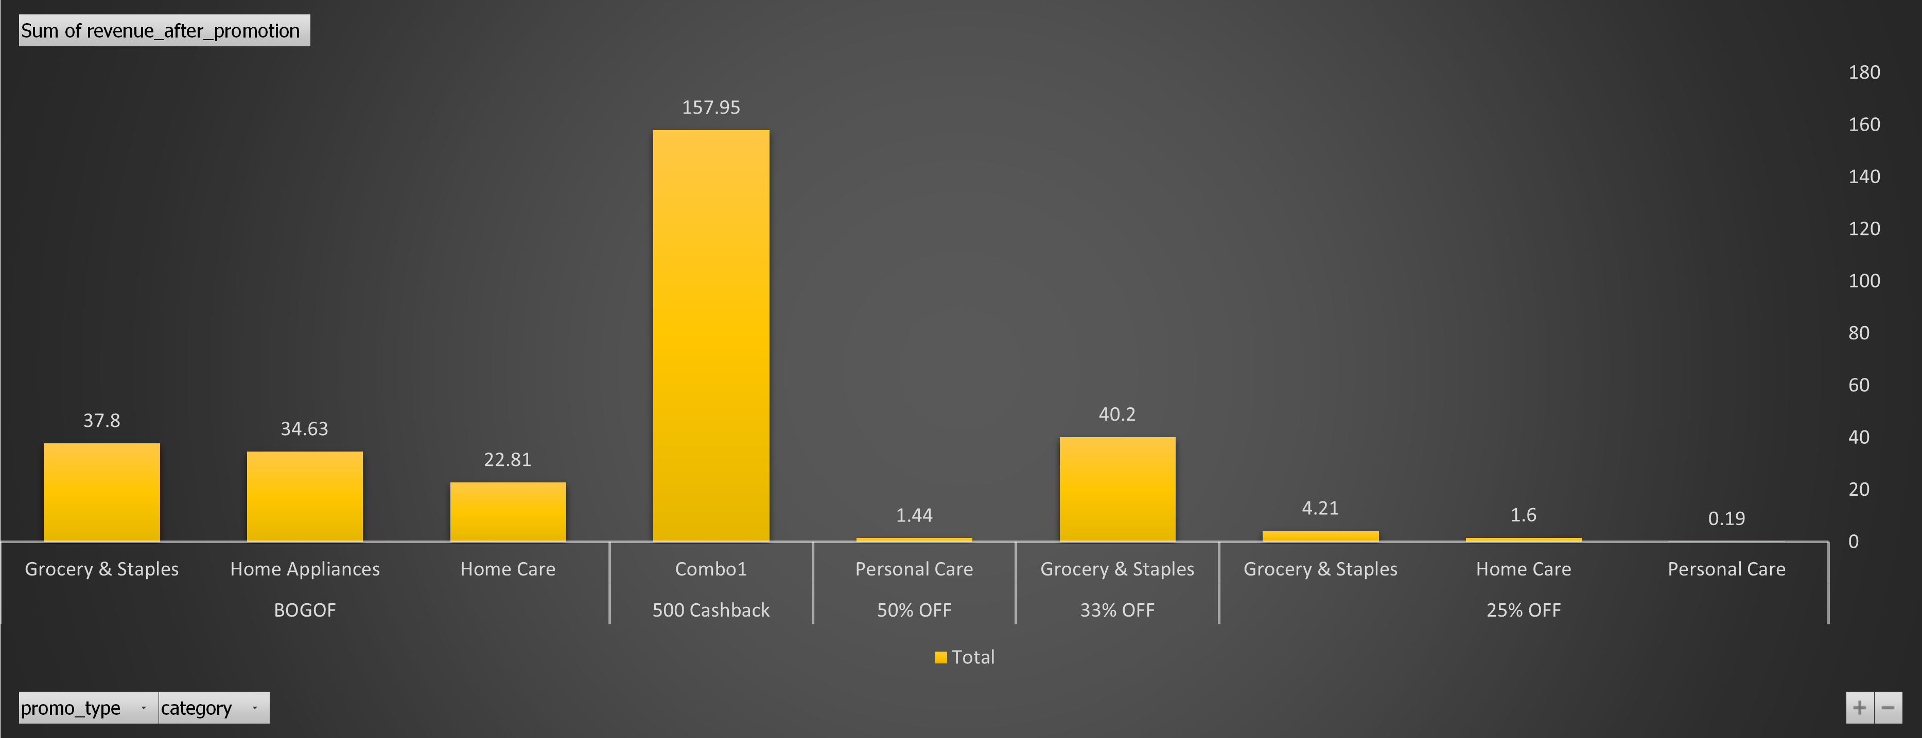
Correlation between product category and promotion type effectiveness.
50% off on Personal Care products did not drive sales.
Grocery and Staples performed better with offers like buy one get one free and 33% off, suggesting a focus on these types of promotions.

Slide 9
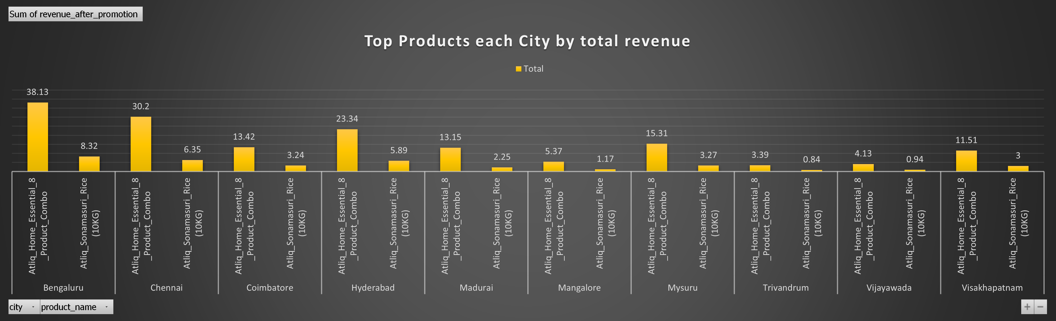
Top Products In each city by promotional revenue.
Atlique Sonamasurri rice and Combo marked most sales in every city during promotional time.
Rice serves as a base for South Indian dishes, complementing the flavors of seafood, fruits, vegetables, and spices.
Rice provides essential energy in the South Indian diet, especially valuable in the region's hot climate, where other foods like seafood and fruit are low in calories.

Slide 10
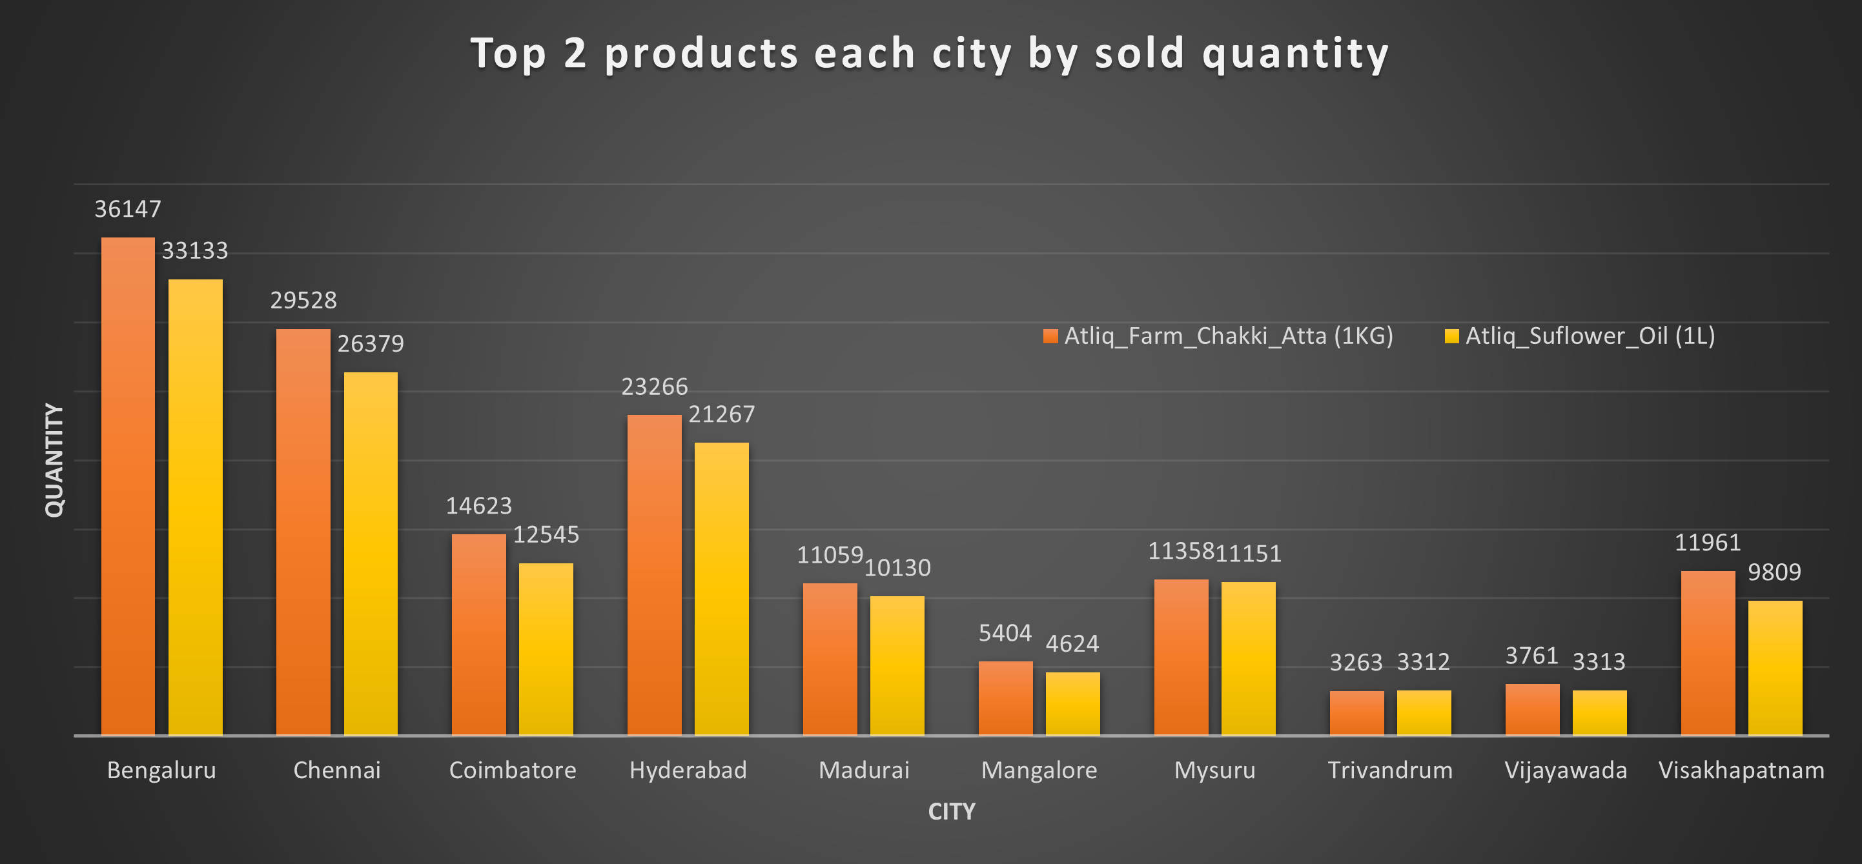
Top products in each city by sold quantity
Farm chakki atta and sunflower oil are the two products each city by their sold quantity.
As always the state capitals have sold more quantity of these products.
These products are essential ingredients for festive recipes, such as charroti and chakli, contributing to their higher sales in state capitals.

Slide 11
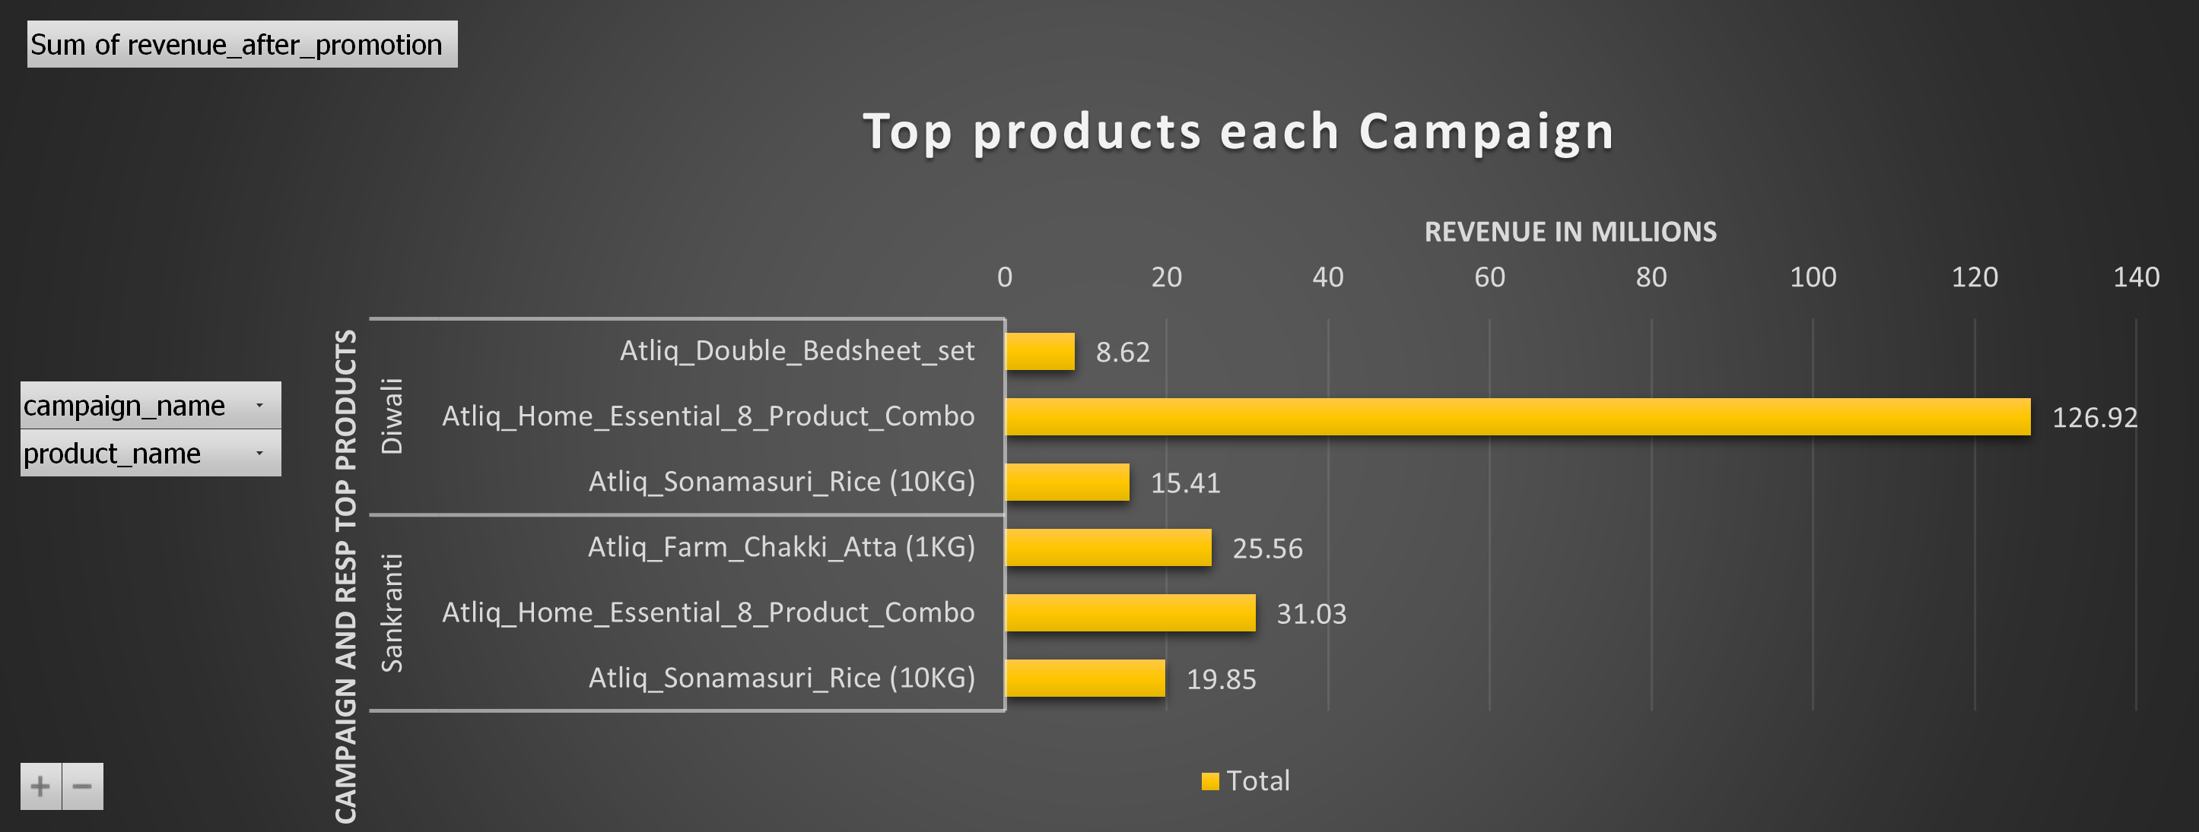
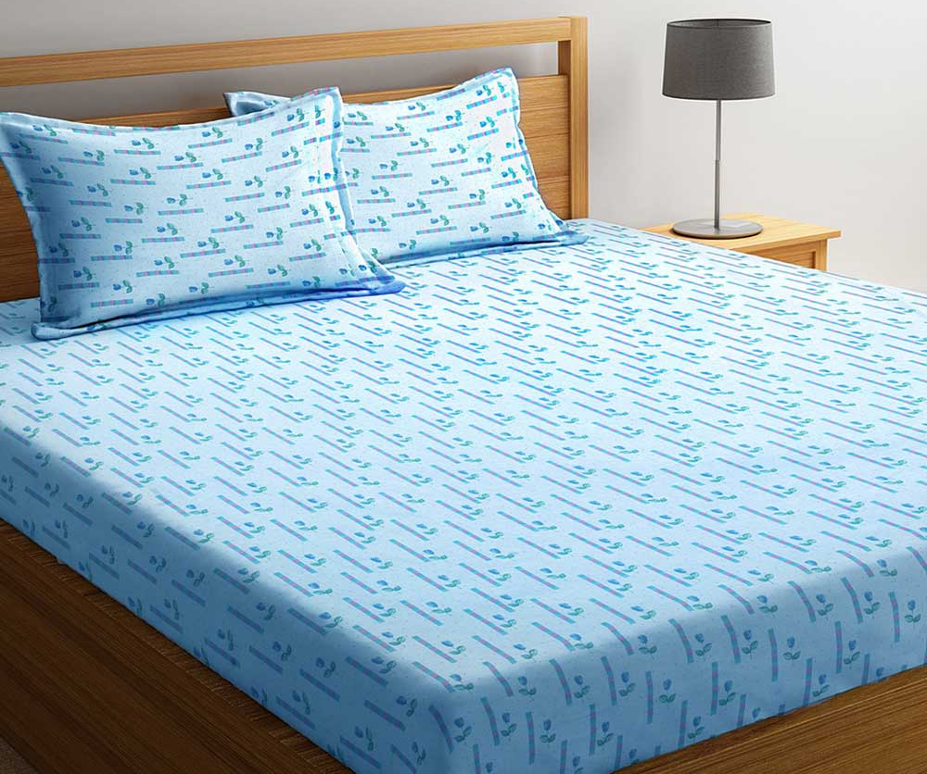
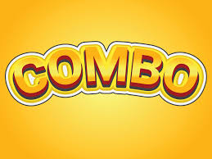
Top products in each campaign by promotional revenue.
Product combo and Sonamasuri Rice played a major role contributing to the revenue during promotional times followed by Double bed sheet and farm chakki atta.

Slide 12
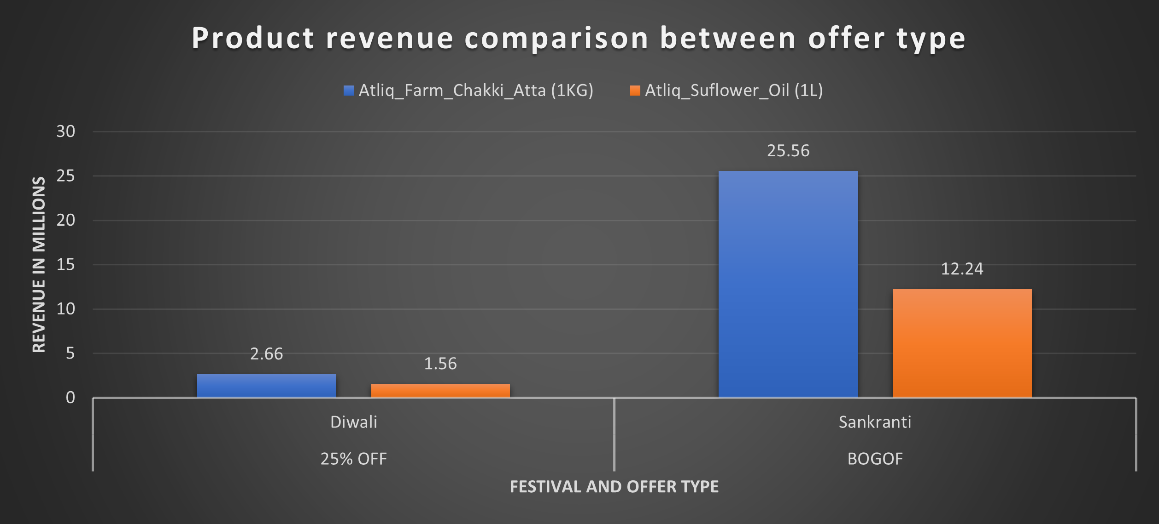
Farm Chakki Atta and Sunflower Oil revenue comparison between campaigns and offers.
Farm Chakki Atta and Sunflower Oil showed a significant increase in revenue during Sankranti compared to Diwali, attributed to the change in offer type from 25% off to buy one, get one free (BOGOF).
These products are essential for preparing festive foods during Diwali and Sankranti, highlighting the effectiveness of BOGOF offers for such promotions.

Slide 13
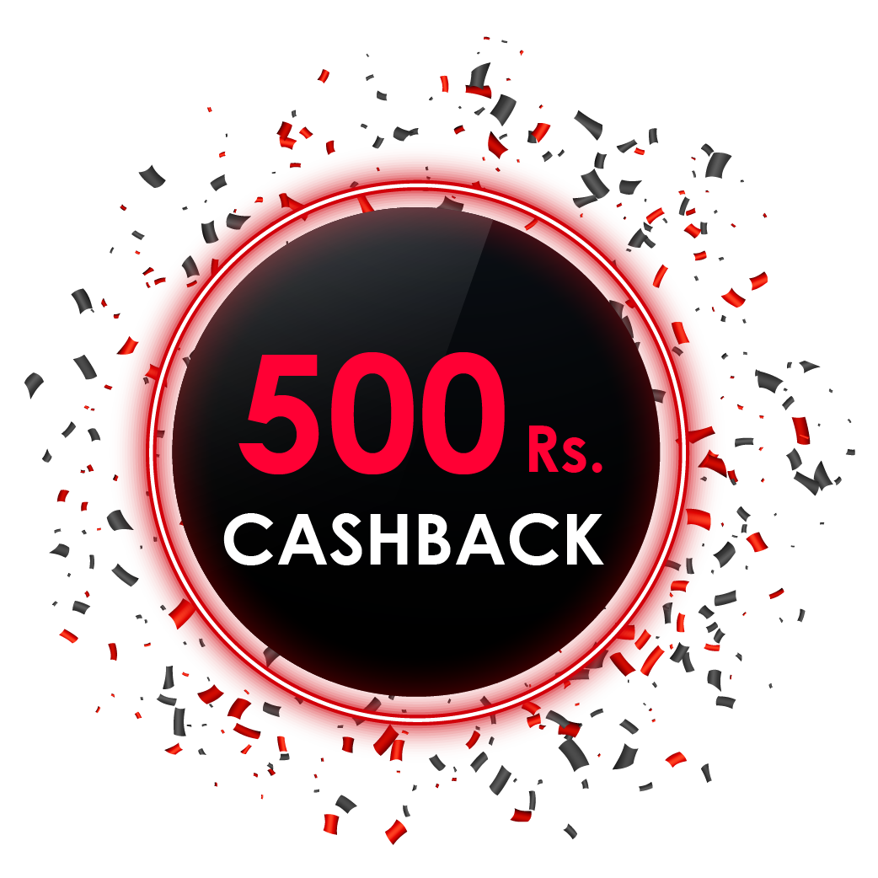

Promotional Performance

Slide 14
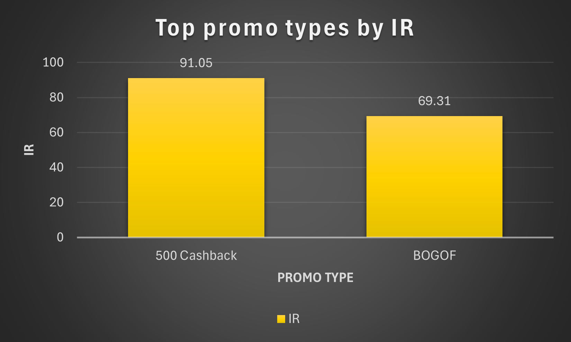
Top 2 promotion types that resulted in the highest Incremental Revenue.
500 cashback and BOGOF resulted in more incremental revenue.
People usually prefer to buy products which has discounts such as these 2.

Slide 15
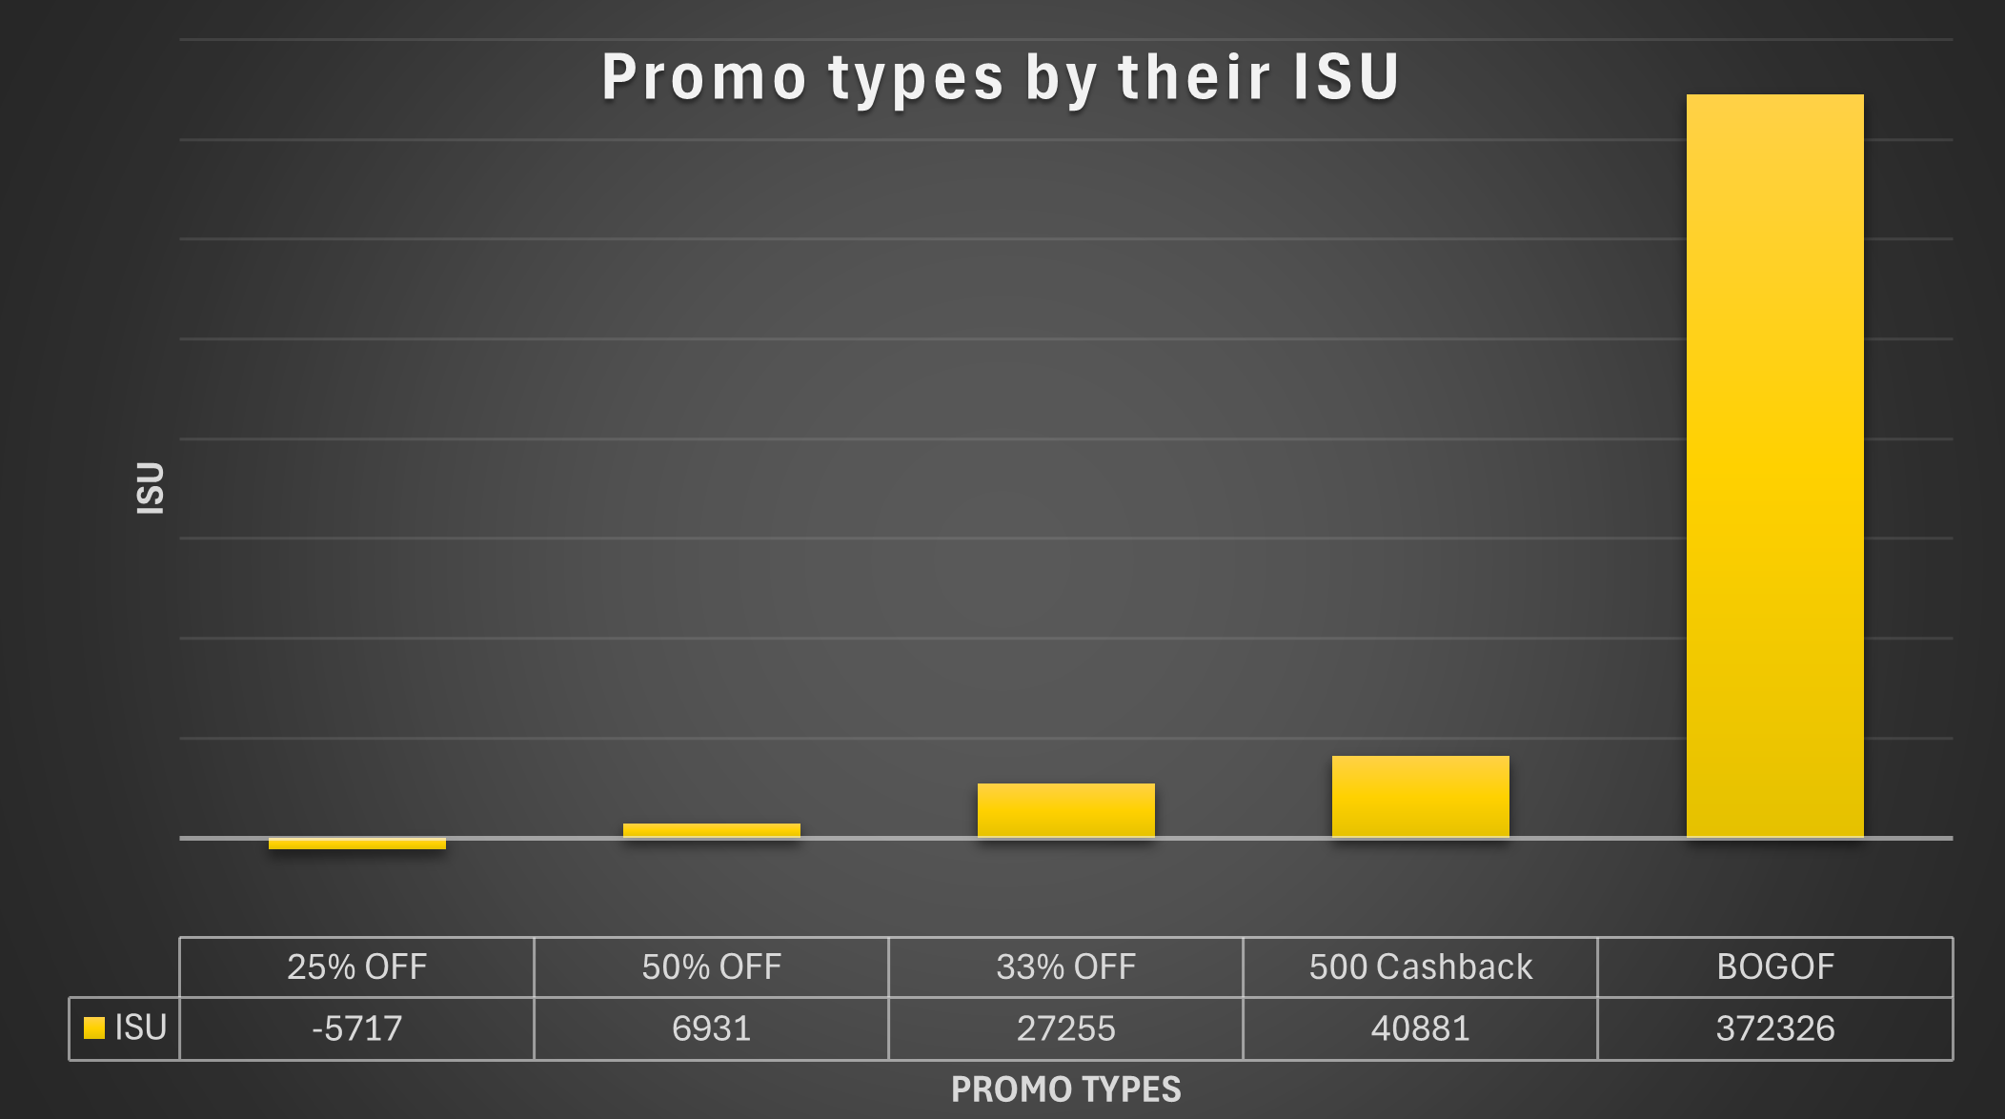
Promotional types by their ISU (Incremental sold units)
Promotional type `25% Off ` performed really bad in both the promotions with a decline in ISU of -5717 units.
`50% Off` also performed slightly better compared to 25% off where it sold 6931 more units during promotional time.
Sunflower oil which was at 25% off during Diwali was shifted to BOGOF which was a better move.

Slide 16
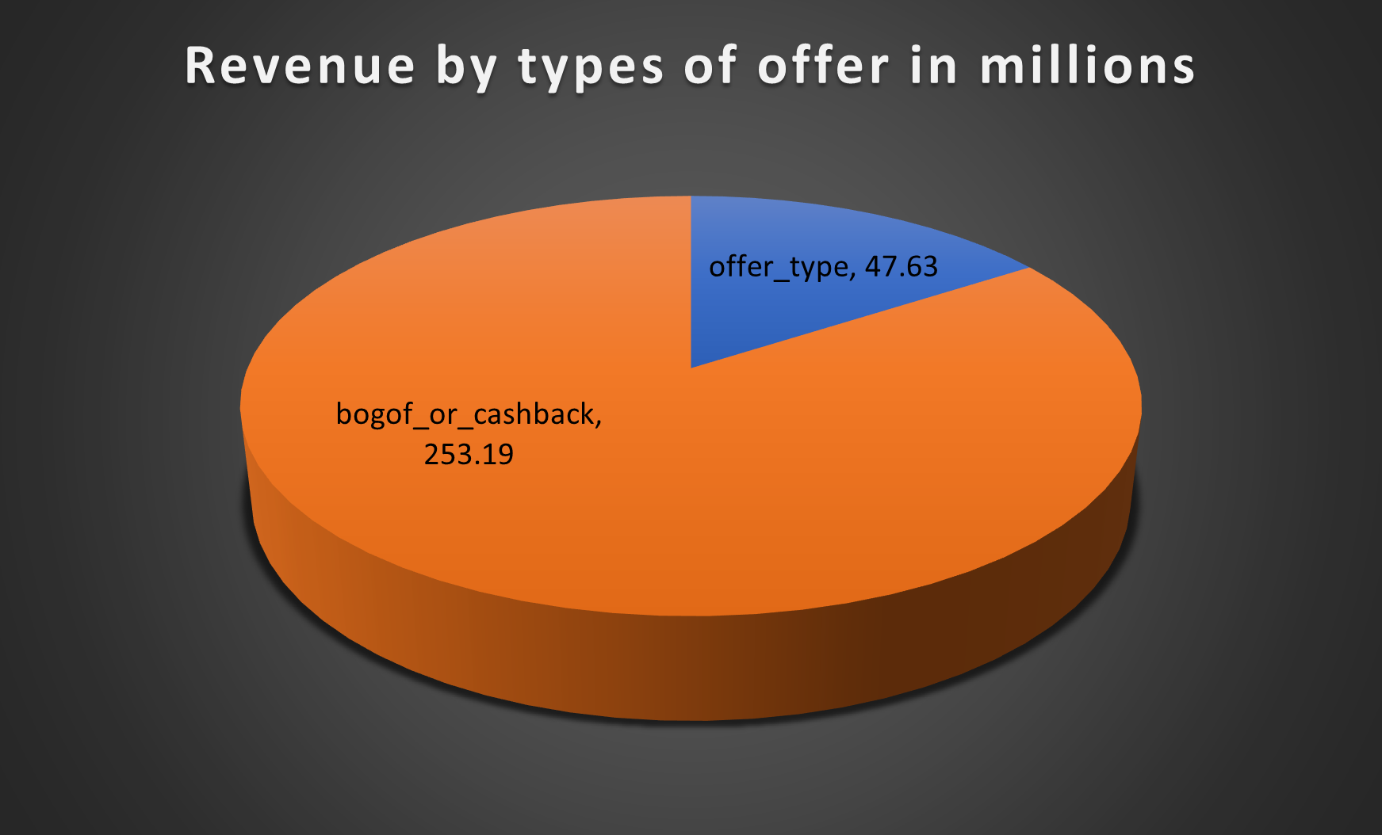
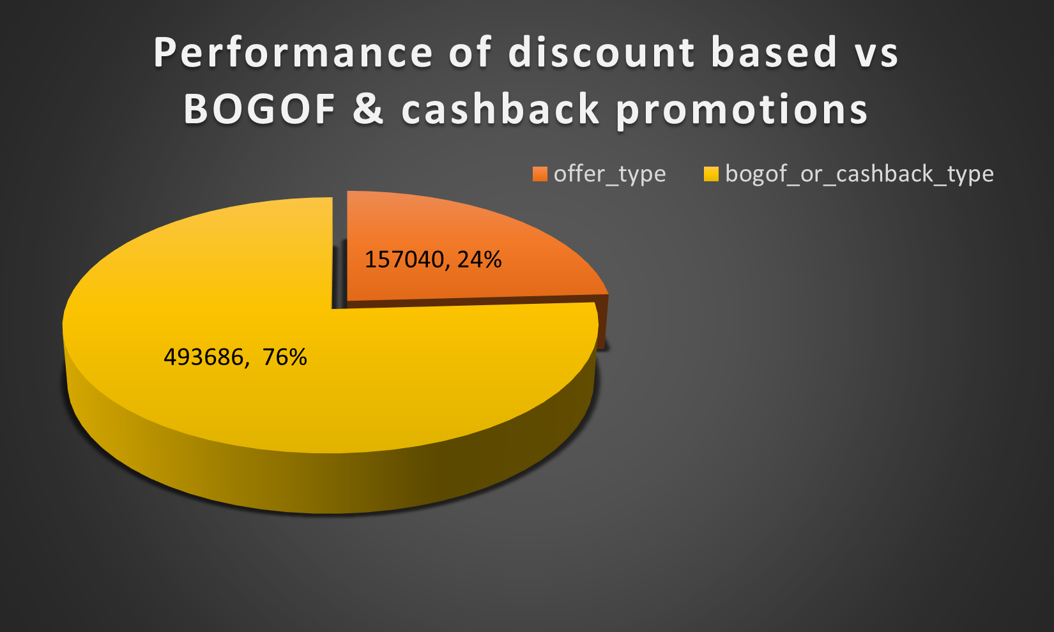
BOGOF & cashback offers V/S Discount based promotional types
By revenue in millions
By Sold quantity during promotional time

Slide 17
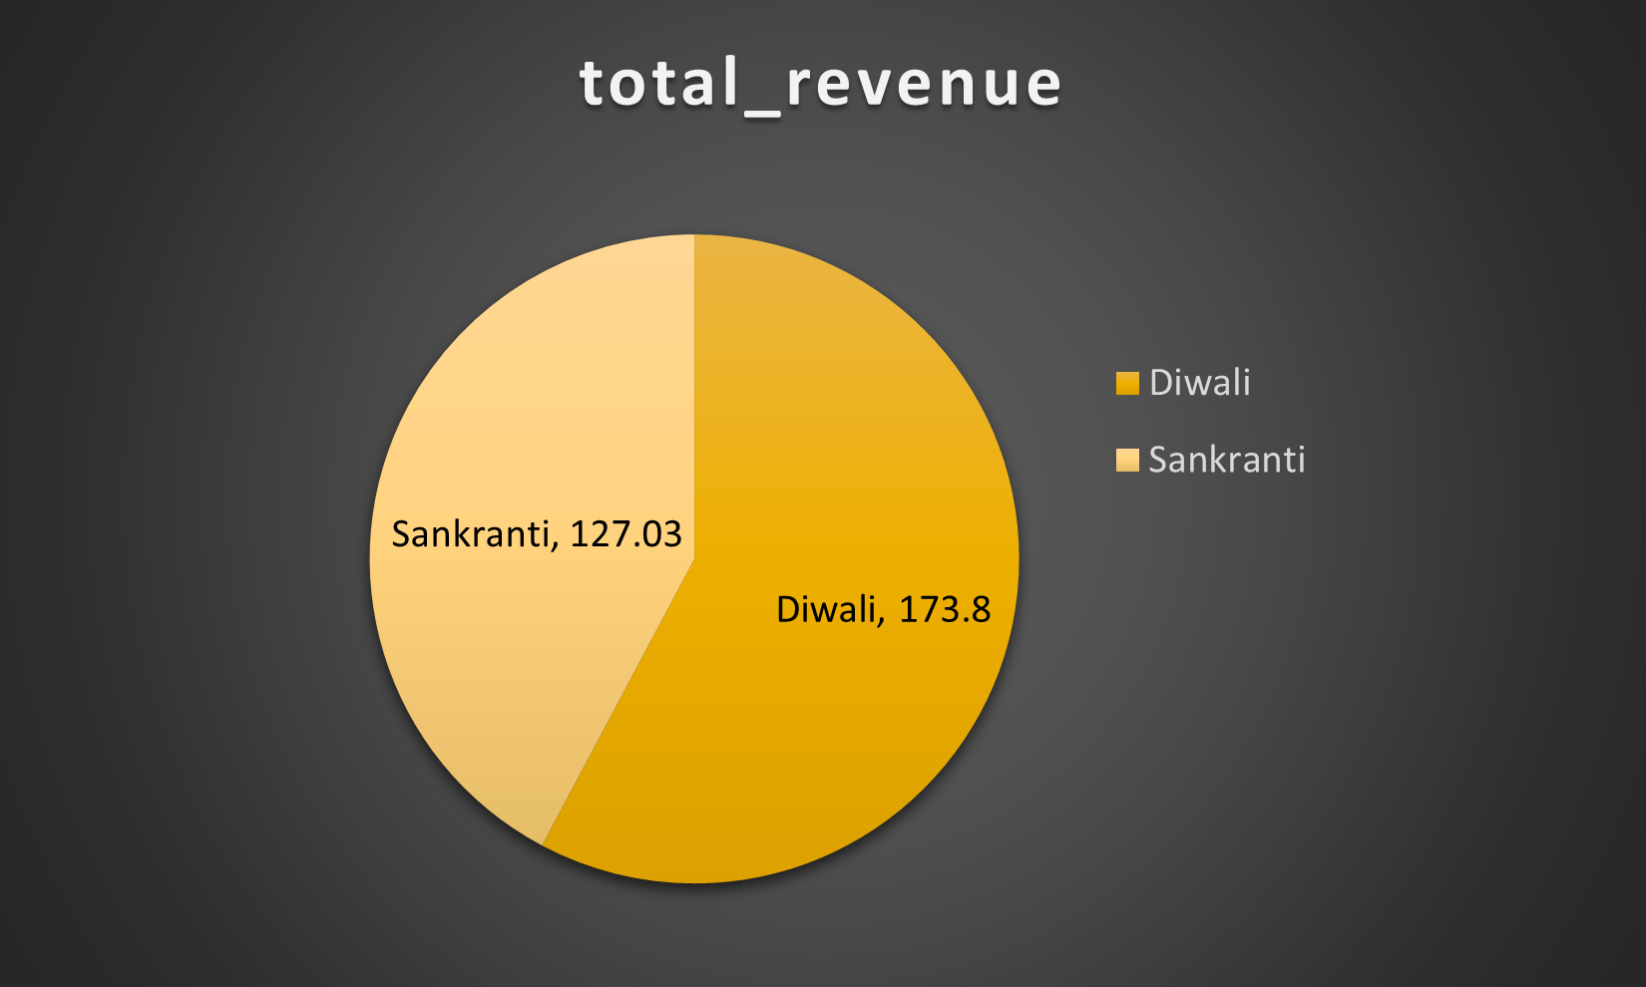
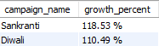
Revenue generated from the campaigns.
During Diwali, Atlique generated a revenue of 173.8 million, while during Sankranti (also known as Pongal in South India), the revenue was 127.0 million, contributing 42% of the total revenue generated during the promotional period.
Although Sankranti had a growth percentage of 118.5 % which is lesser than Diwali.

Slide 18
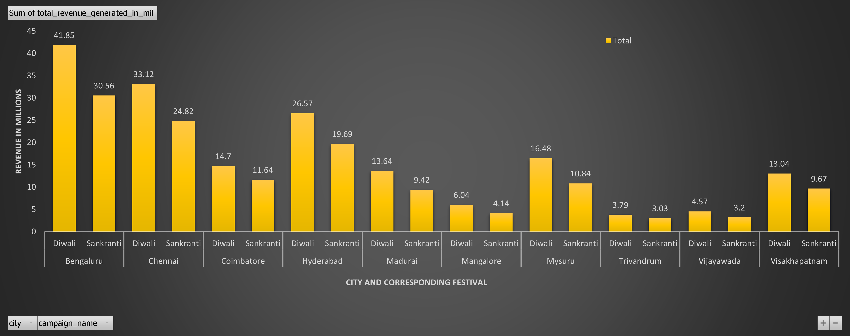
Revenue generated from the campaigns in each city.
Diwali campaigns in all cities outperformed state capitals, driven by the larger population in these areas.
Bengaluru ,Chennai,Hyderabad have shown higher sales during both the campaigns.

Slide 19
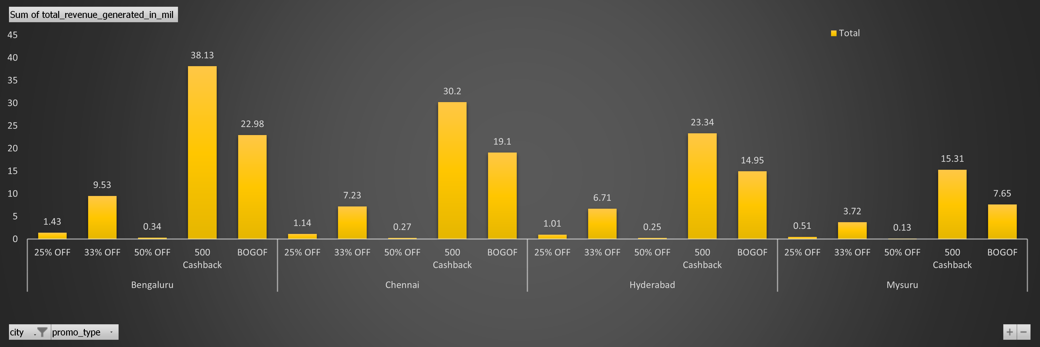
Cities and respective promo type.
Access these interactive charts from the link given at the end or from the post.

Slide 20
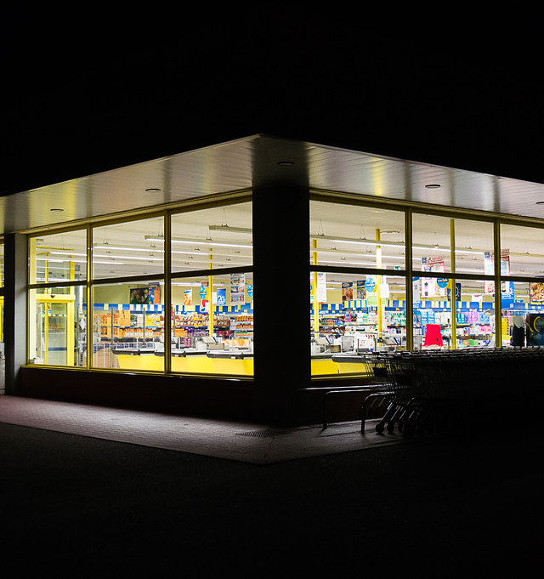
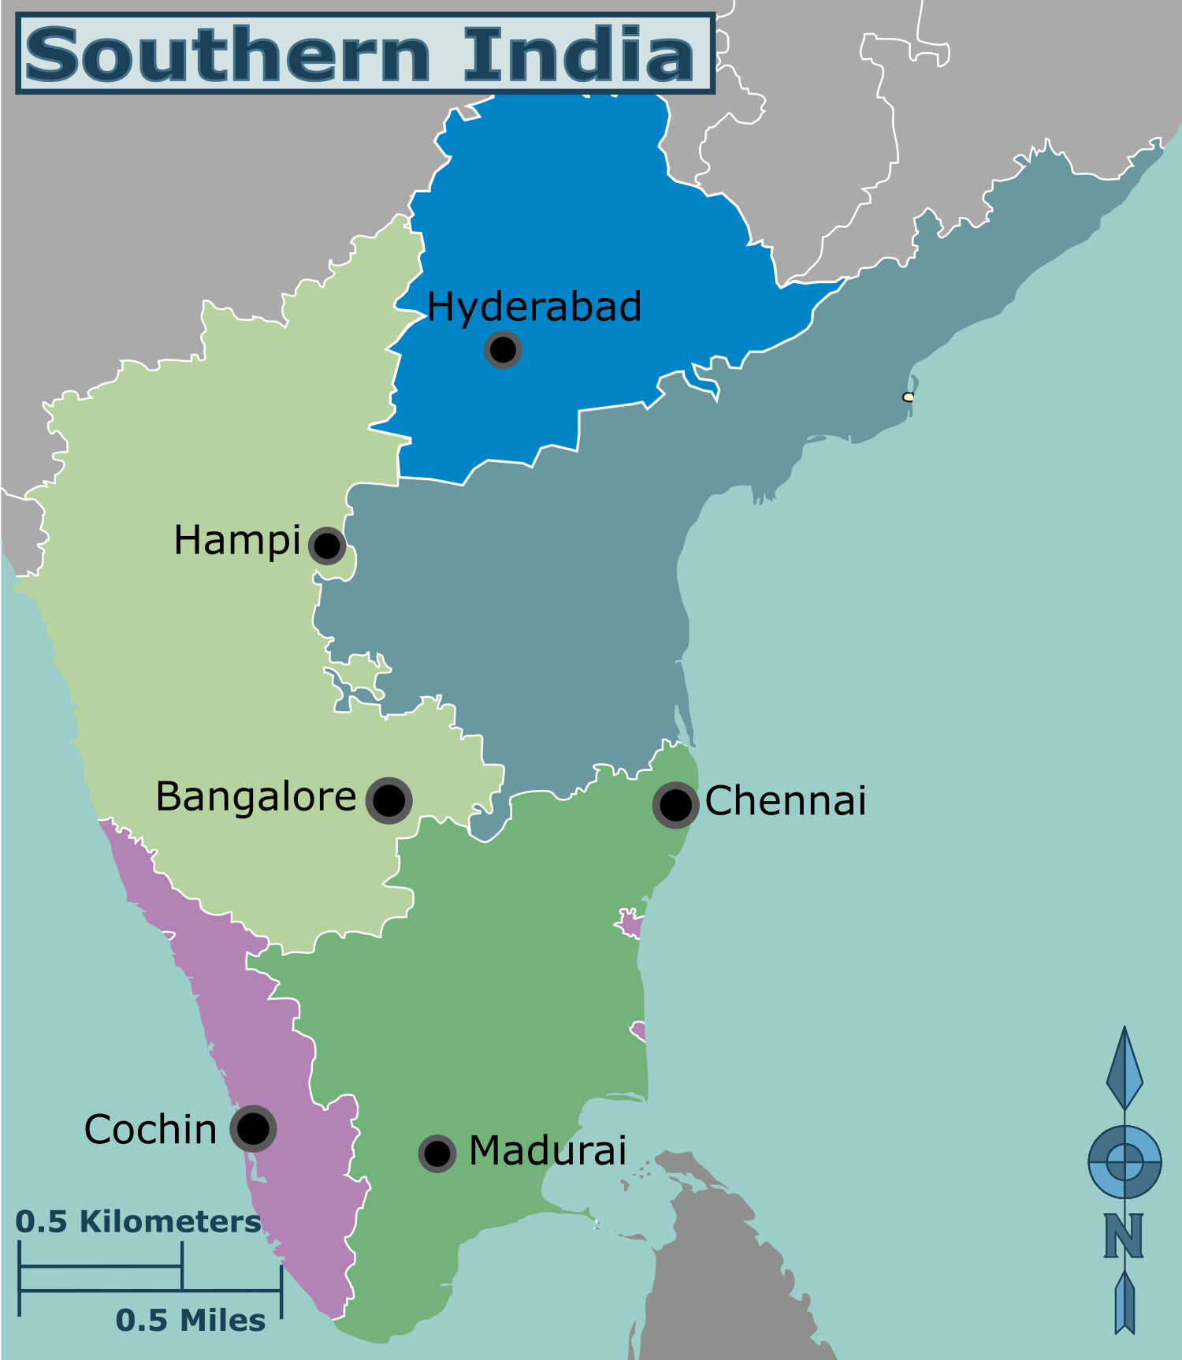
Store Performance

Slide 21
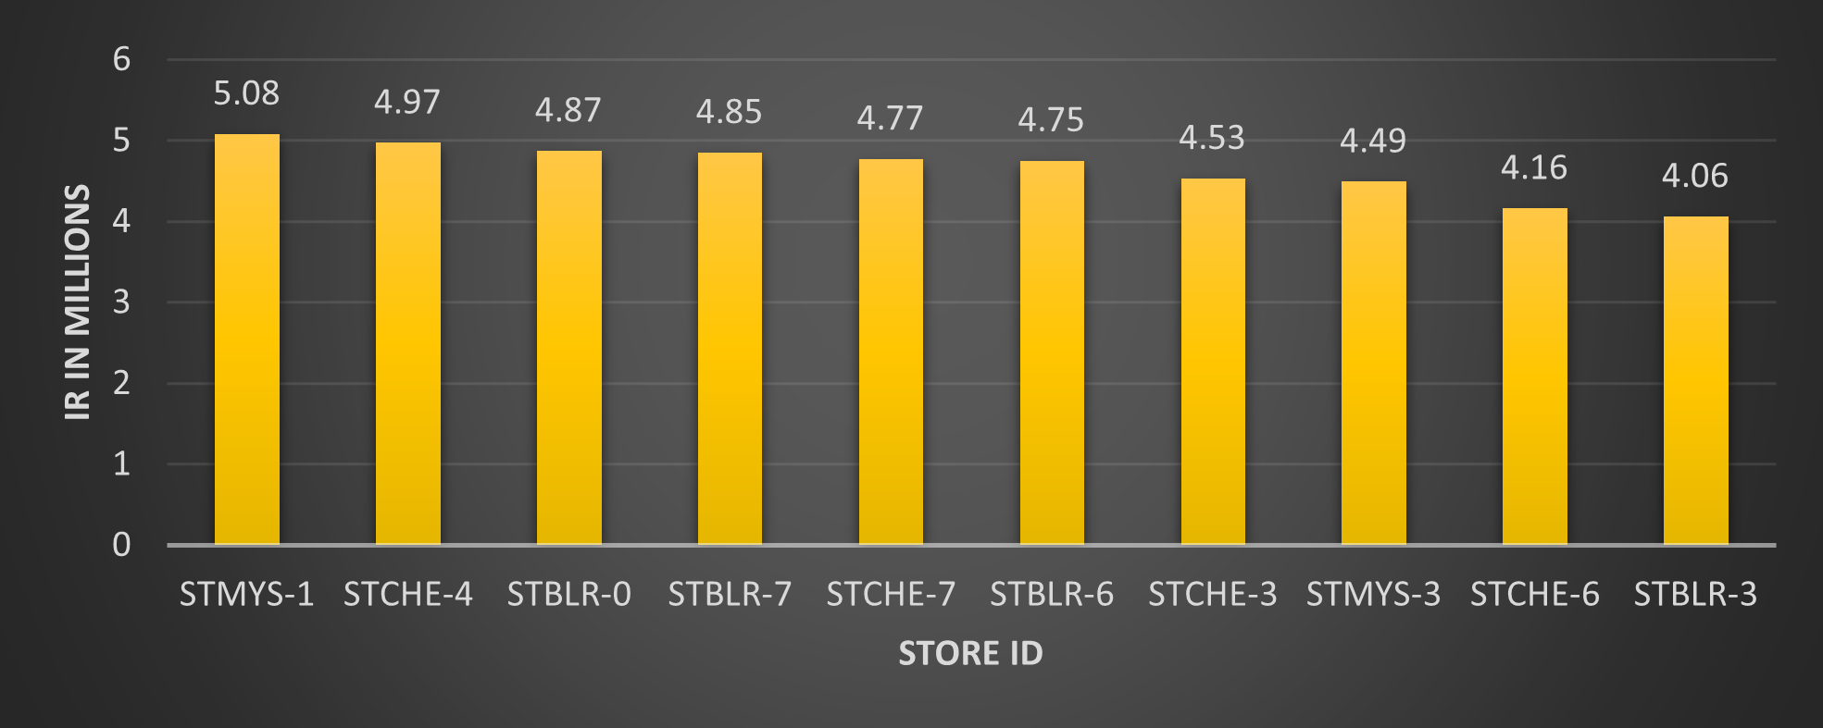
Top 10 stores by Incremental revenue
Store 1 of Mysuru has generated incremental revenue of 5.08 ml followed by store 4 of Chennai with of 4.97 million.

Slide 22
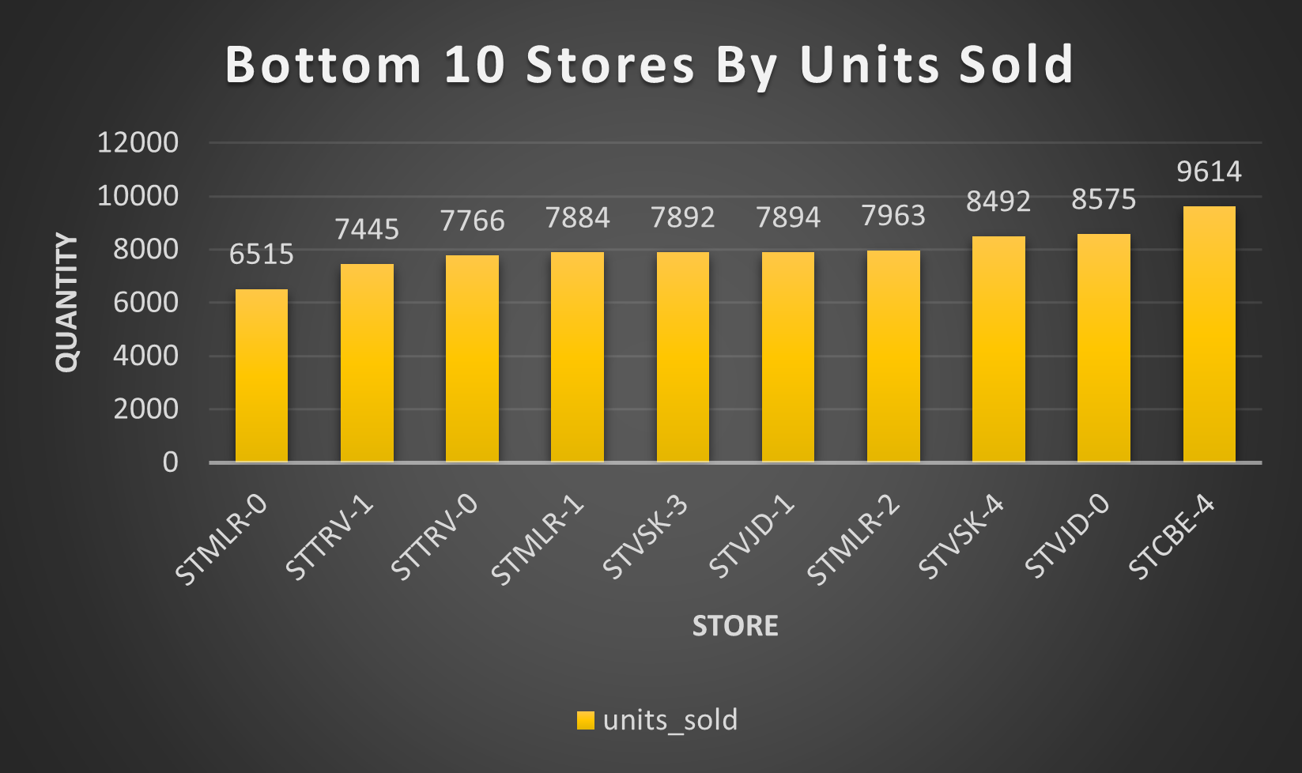
Bottom 10 stores by Incremental Sold units

Slide 23
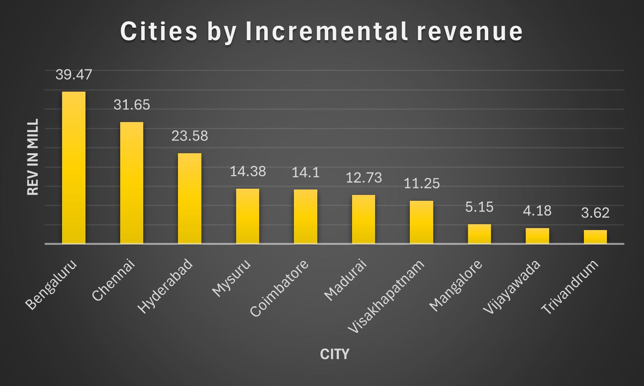
Top cities by incremental revenue.
State capitals have generated more incremental revenue.
Should try Kochi and other densely populated cities

Slide 24
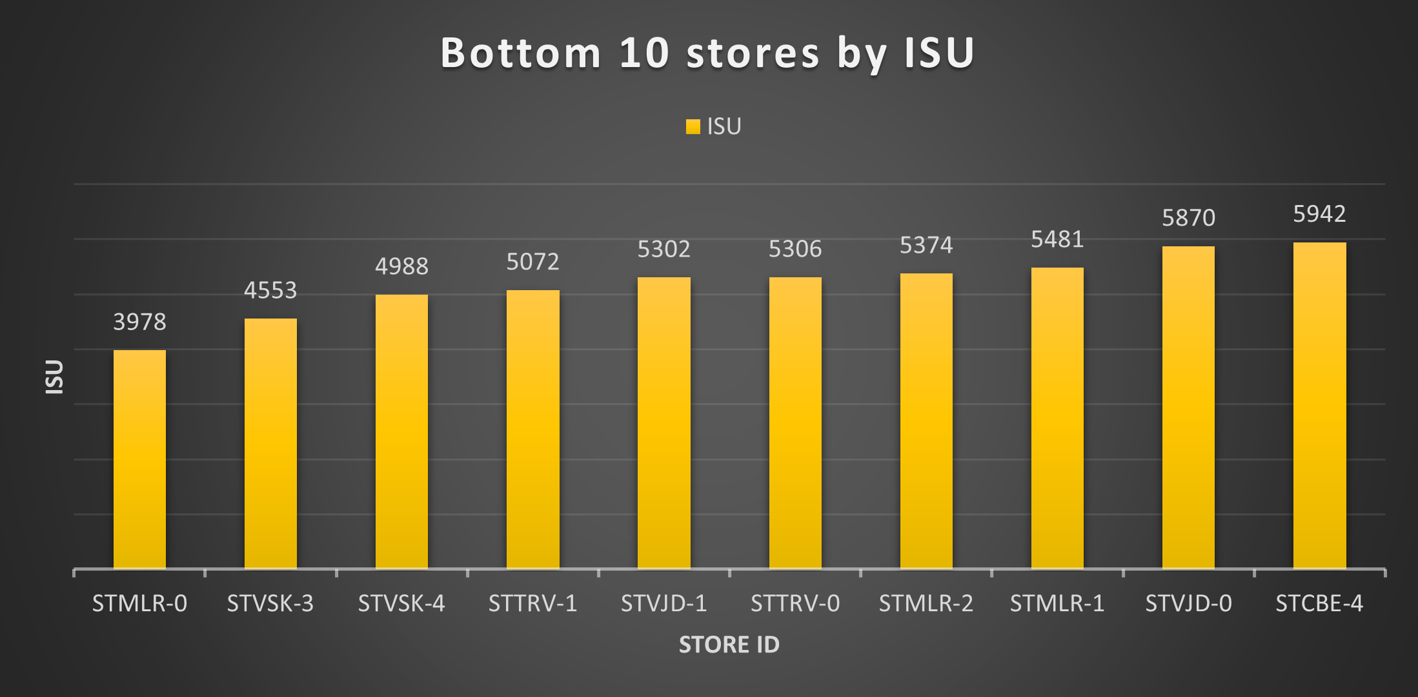
Bottom 10 stores by ISU

Slide 25
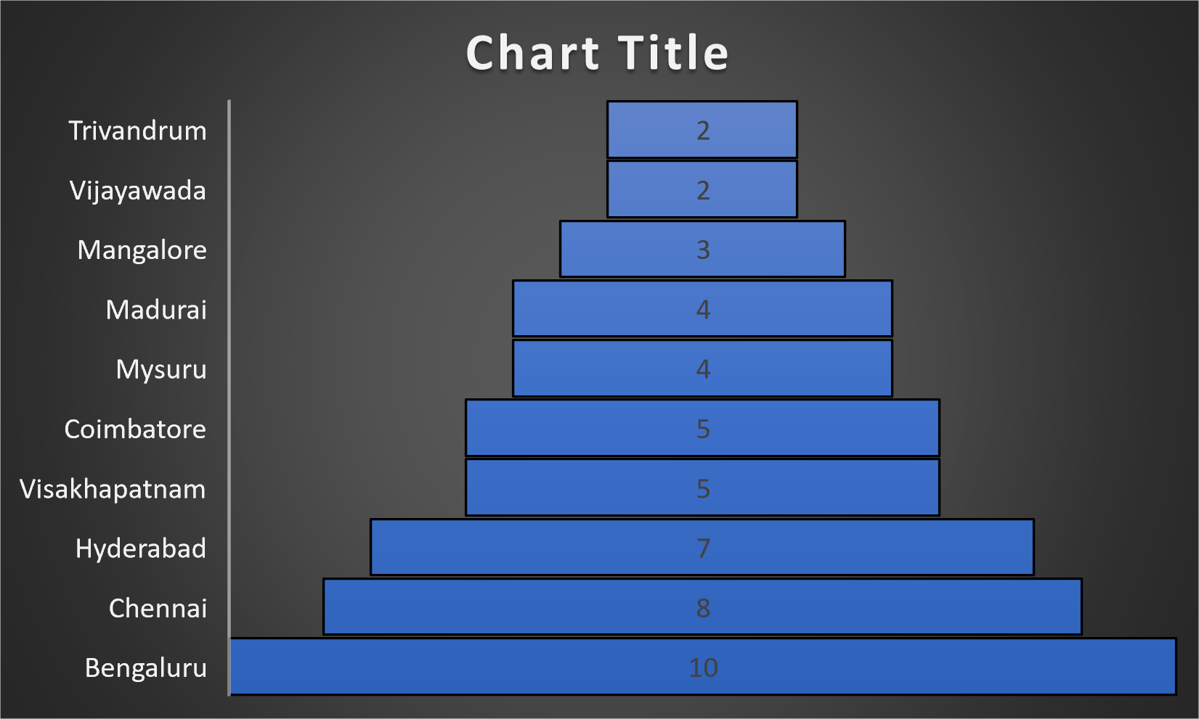
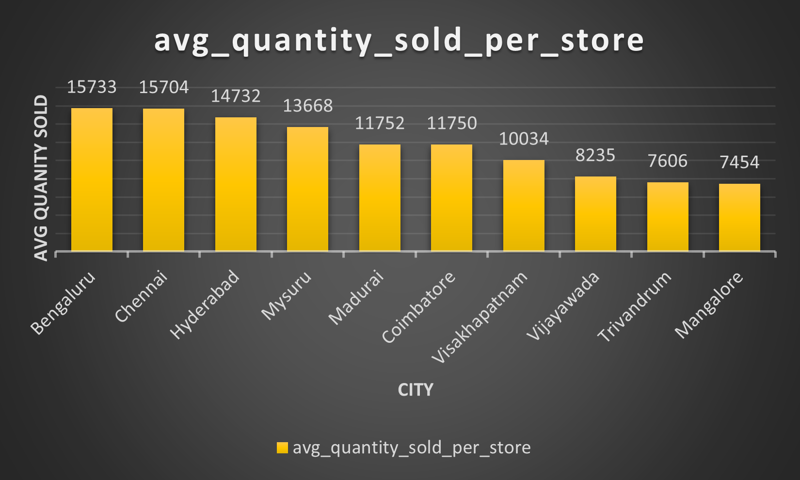
Average quantity sold per city during promotional period
No of stores in each city.
Average units sold in each store in each city

Slide 26
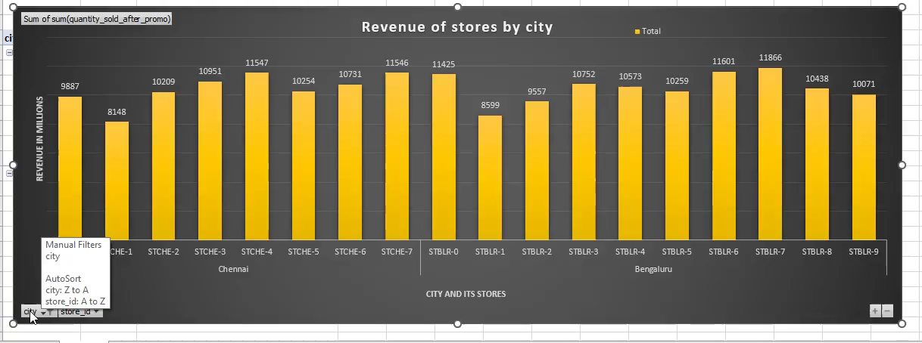
Variation of stores across cities
More population has lead to the development of more number of stores which in turn has lead to more revenue in state capitals and some densely populated cities.

Slide 27

Ad-Hoc Requests

Slide 28
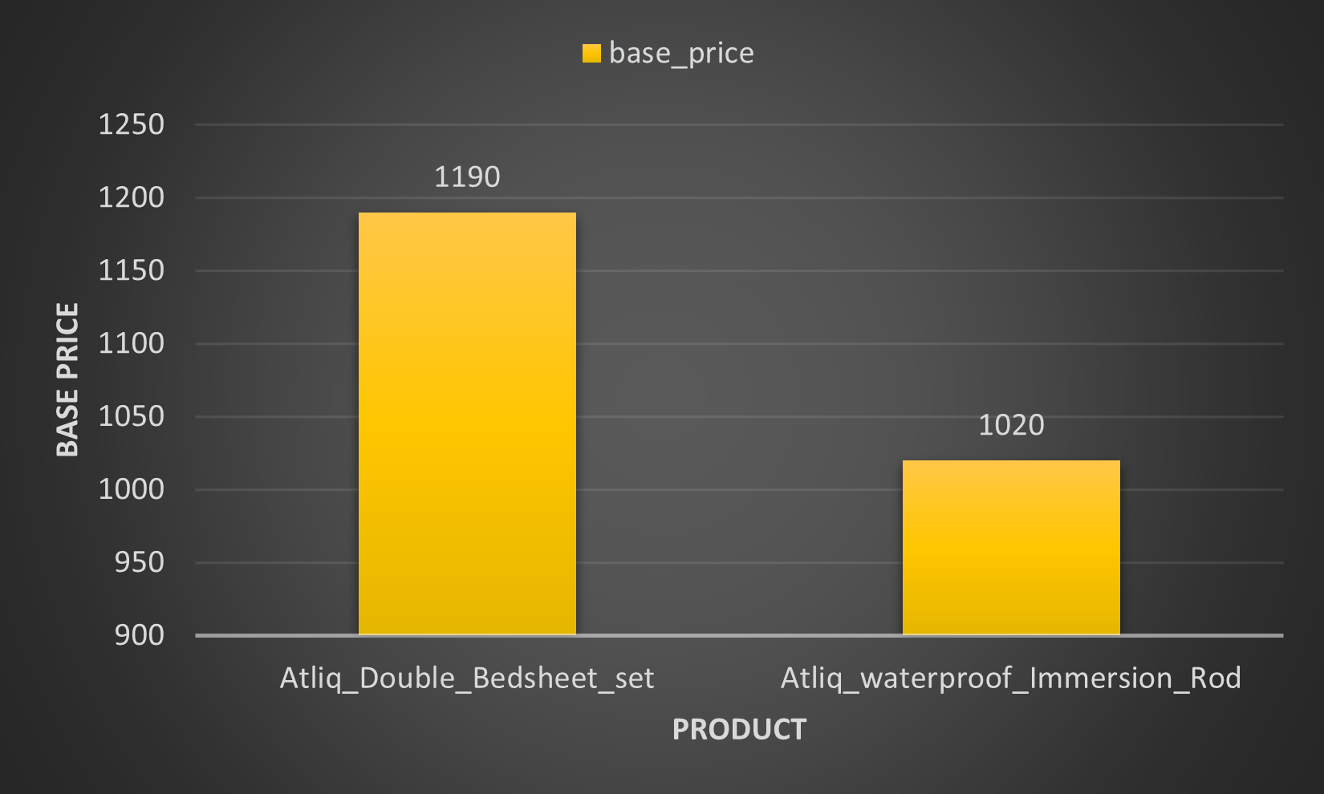
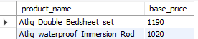
Provide a list of products with a base price greater than 500 and that are featured in promo type of 'BOGOF' (Buy One Get One Free).
Double bed sheet and Waterproof Immersion Rod are the products having base price greater than 500 and have the promo type applied Buy One get one free.
This has lead to more sales of these products because of common human tendency of buying products with Buy one get one and free.

Slide 29
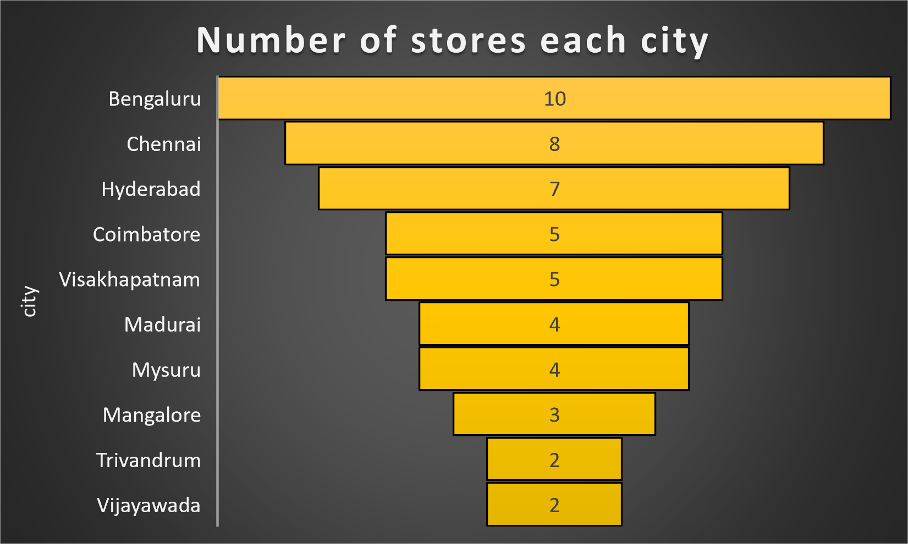
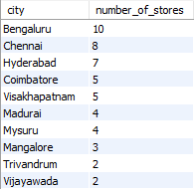
Provides an overview of the number of stores in each city
Atlique should try to build more stores in Chennai and should try to expand in cities of kerela .

Slide 30
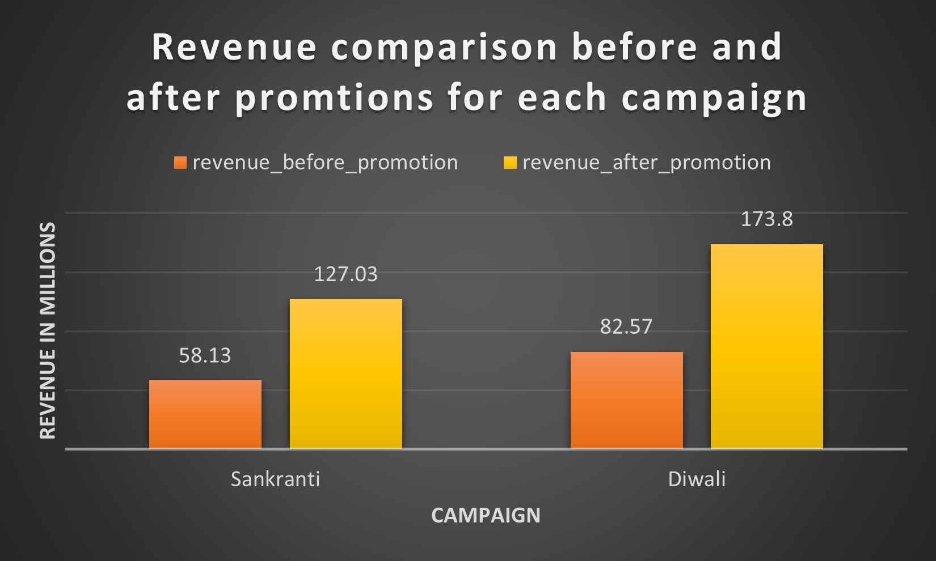
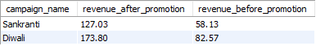
Displays each campaign along with the total revenue generated before and after the campaign
Though Diwali campaign generated more revenue than the Sankranti campaign but when we the perecentage growth Sankranti has 118.53% more growth during the promotional period compared to the non promotional period.

Slide 31
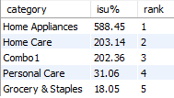
Produce a report that calculates the Incremental Sold Quantity (ISU%) for each category during the Diwali campaign. Additionally, provide rankings for the categories based on their ISU%. The report will include three key fields: category, isu%, and rank order.
Home Appliance,Combo1 and Home care have shown better results in term of ISU percentage.

Slide 32
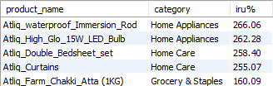
Create a report featuring the Top 5 products, ranked by Incremental Revenue

Slide 33
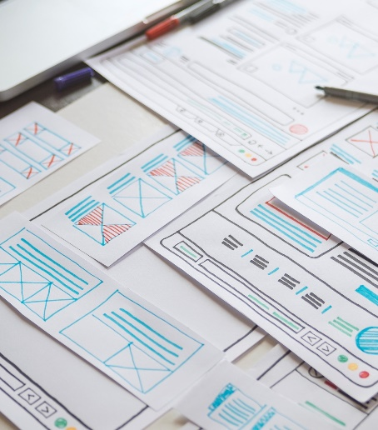
More Recommendations
Product Optimization.
Store Expansion.
Promotion Strategy Refinement.
Seasonal Campaign Optimization.

Slide 34
Summary
AtliQ Mart's promotions during Diwali and Sankranti were highly successful, with Diwali generating more revenue but Sankranti showing higher growth percentage.
Cities like Bengaluru, Chennai, and Hyderabad performed exceptionally well due to their larger populations and higher number of stores.
There is potential for growth in cities like Mangalore, Vishakapatnam, Trivandrum, and Madurai, where the average units sold per store are promising.
Certain promotion types, such as buy one, get one free (BOGOF) and cashback offers, were more effective than others like percentage-based discounts.
Product categories like Grocery and Staples, particularly Combo1, saw significant increases in sales during the promotional period, indicating a preference for bundled offerings.
Home appliances and combo deals were particularly successful, while personal care products performed relatively poorly in terms of incremental revenue.

Slide 35
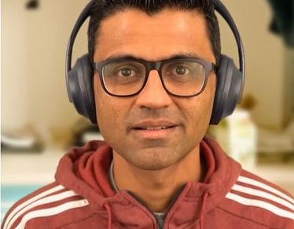
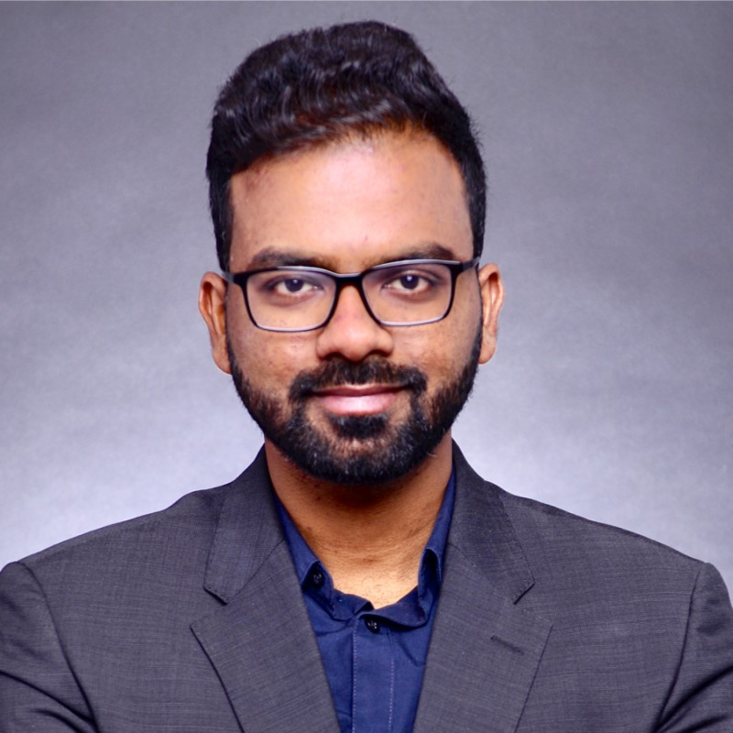

Sincere Thanks To..
Dhaval Patel
Hemanand Vadivel

Slide 36








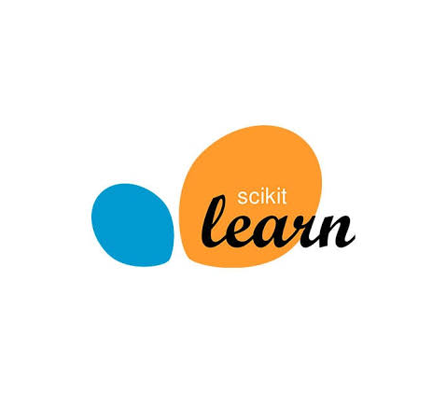

Thank You
Vivek Chouhan
Viv696969
vivek-chouhan

